Slide 1
CSc 134
Database Management Systems
10. Introduction to Query Processing
Ying Jin
Computer Science Department
California state University, Sacramento

Slide 2
Query Execution Architecture
Query
Parser
Preprocessor
Logical query plan generator
Physical query plan generator

Slide 3
Parser and Preprocessor
Parser
  Define grammar
  Parse Query in a high-level language
  Generate parse tree
Preprocessor
  Replace view with a parse tree that describes the view
  Semantic checking

Slide 4
Logical Query Plans
Query tree: a tree data structure that corresponds to a relational algebra expression.
Leaf nodes - input relations
Internal nodes - relational algebra operations

Slide 5
Example
SELECT LNAME
FROM EMPLOYEE, WORKS_ON, PROJECT
WHERE PNAME = ‘AQUARIUS’ AND PNMUBER=PNO AND
ESSN=SSN AND
BDATE > ‘1957-12-31’;

Slide 6
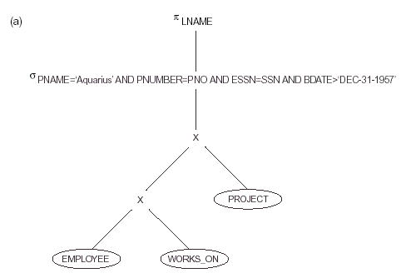

Slide 7
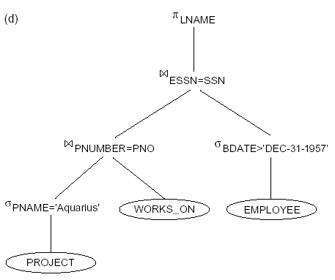

Slide 8
Physical Query Plans
logical plan -> n physical query plans
Algorithms to implement an operator (e.g. union, join)
Cost_based plan Selection

Slide 9
These slides are based on the textbook:
R. Elmaseri and S. Navathe, Fundamentals of Database Systems, 7th Edition, Addison-Wesley.

